Slide 1
IEEE GUIDED PROJECT IMPLEMENTAION OF DETECTION OF COVID 19 USING PRE COVID DATA
GROUP NO:09

Slide 2
INTRODUCTION
Rapid and accurate detection of COVID-19 ,timely quarantine and medical treatment in absence of any vaccine is necessity of time to prevent and control of this pandemic.
Therefore, an alternative diagnostic tool to detect COVID-19 cases utilizing available resources such as Image Processing and advanced deep learning techniques is proposed in this work
The proposed method is implemented in four phases, viz., data collection through kaggle, Image Processing & Compare with given sample, predicting and calculating using ML, display of result.

Slide 3
SR NO | TITLE | AUTHOR | PUBLICATION | DATA SET
1 | A deep learning approach to detect Covid-19 coronavirus with X-Ray images | Govardhan Jain Deepti Mittal, Daksh Thakur, Madhup K. Mittal | NCIB | Open source from Cohen and Kaggle
2 | Machine learning based approaches for detecting COVID-19 using clinical text data | Akib Mohi Ud Din Khanday, Syed Tanzeel Rabani, Qamar Rayees Khan, Nusrat Rouf & Masarat Mohi Ud Din | International Journal of Information Technology | https://github.com/ieee8023/covid-chestxray-dataset/blob/master/metadata.csv

Slide 4
WORKFLOW
Data Collection through Kaggle
Image Processing & Compare with given Sample
Predicting &
Calculating using ML
Display of Result

Slide 5
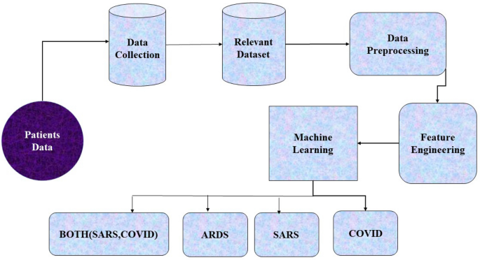

Slide 6
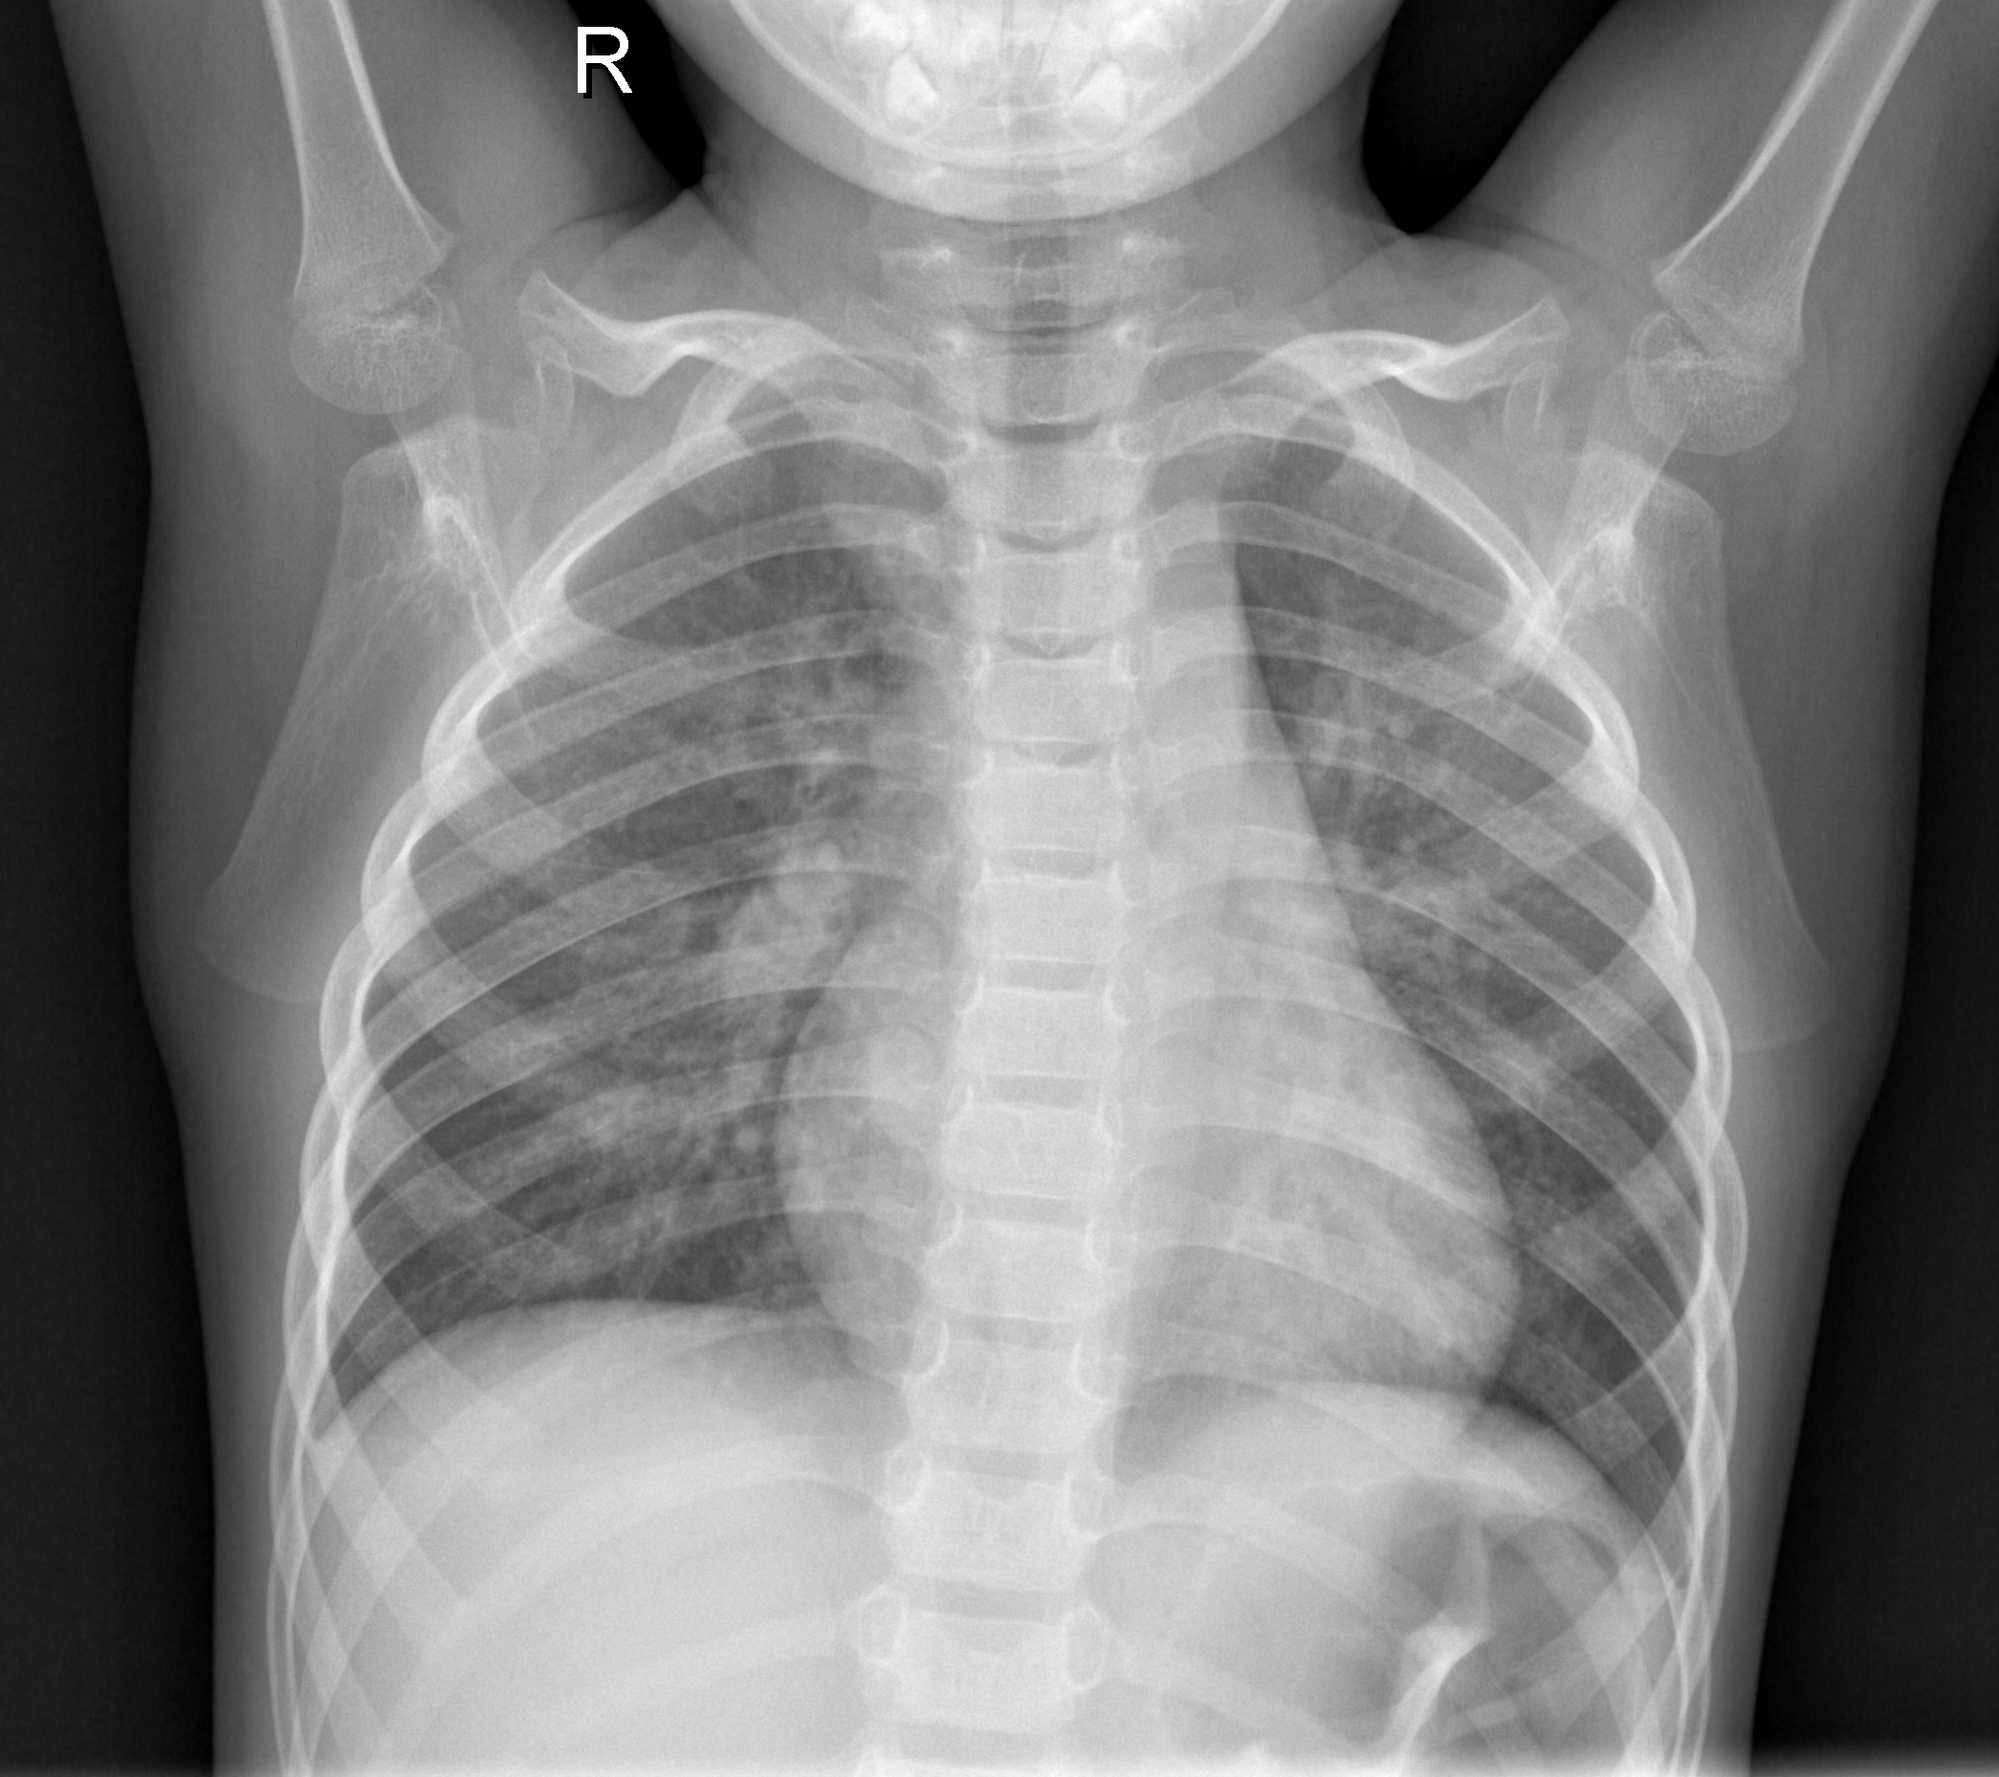
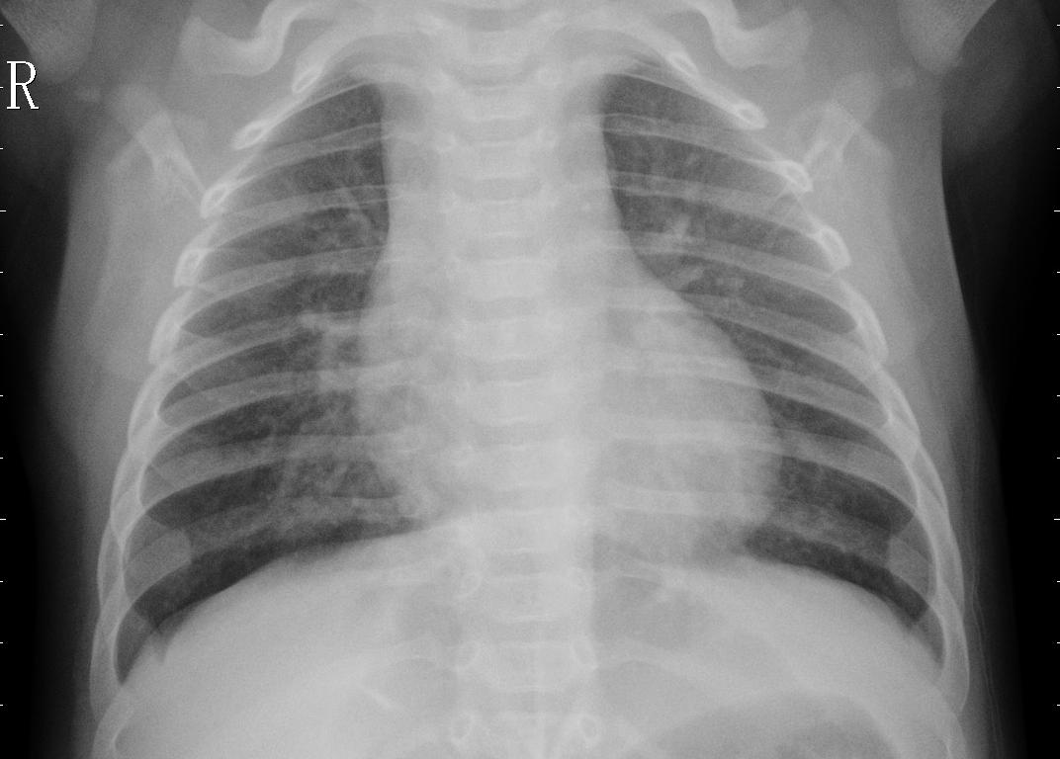
DATA SET USED
https://www.kaggle.com/paultimothymoo...
From this data set X-Ray images of covid +ve and normal patient images are to be used
Normal patient Covid +ve patient

Slide 7
Code for reading and displaying data set
Functions used for reading and displaying data
datapath:-To give the path of required image.
datastore:-To store image in a variable.
total-split:-Determining the splitup.
num-images:-To count the no of images.
subplot images:-Subplot(m,n,p) divides the current figure into m by n grid &creates axes in position specified by p.

Slide 8
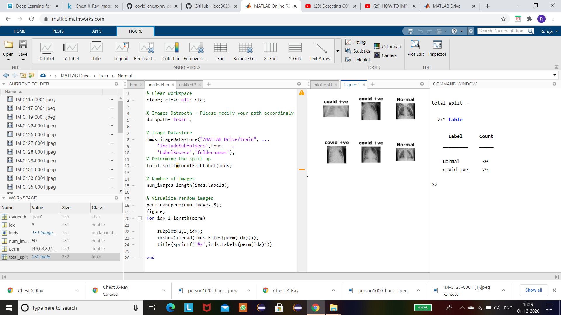

Slide 9
Image Preprocessing
Converting Image (COVID +) to Grayscale
Applying Filter

Slide 10
ML Algorithm to be used
K-fold Cross-validation is a statistical method used to estimate the skill of machine learning models .
It is commonly used in applied machine learning to compare and select a model for a given predictive modeling problem.
Because it is easy to understand, easy to implement, and results in skill estimates that generally have a lower bias than other methods.

Slide 11
How the algorithm works?
The procedure has a single parameter called k that refers to the number of groups that a given data sample is to be split into and hence the procedure is often called k-fold cross- validation.
The general procedure is as follows:
Shuffle the dataset randomly.
Split the dataset into k groups
For each unique group:
a)Take the group as a hold out or test data set
b)Take the remaining groups as a training data set
c)Fit a model on the training set and evaluate it on the test set
d)Retain the evaluation score and discard the model
Summarize the skill of the model using the sample of model evaluation scores

Slide 12
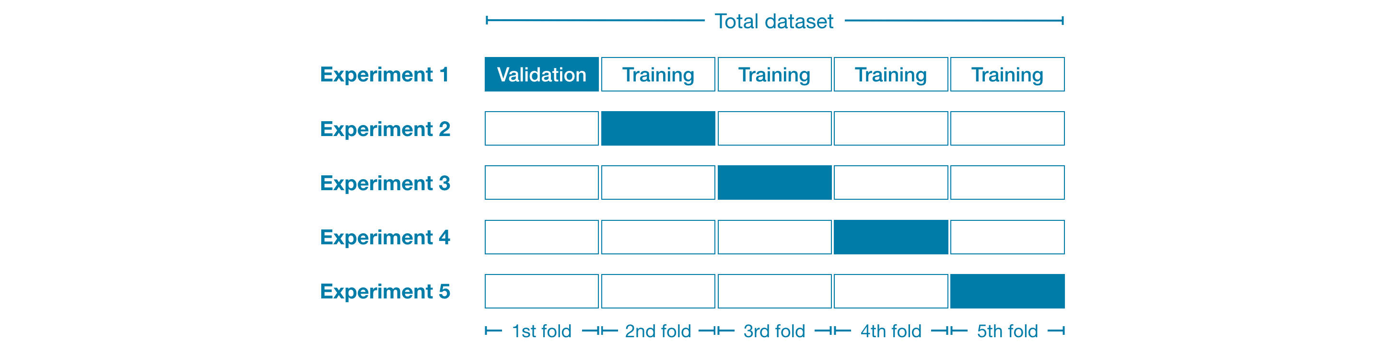

Slide 13
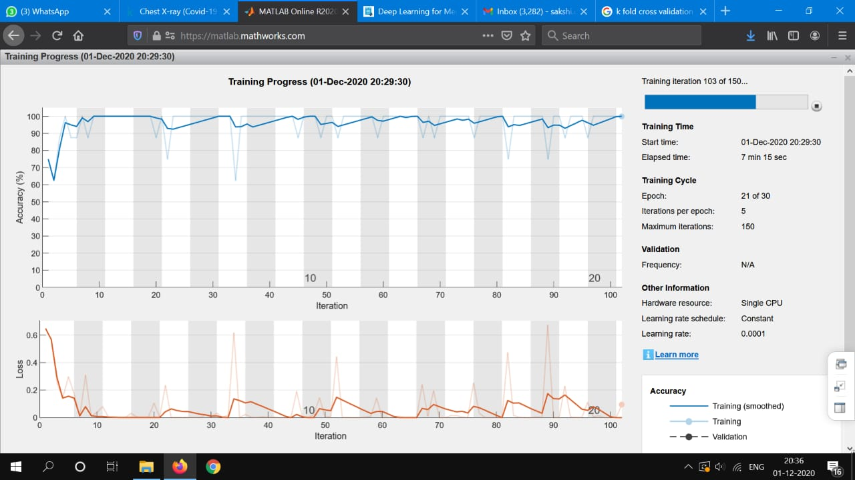

Slide 14
Display of Result
Final display of result i.e positive or negative

Slide 15
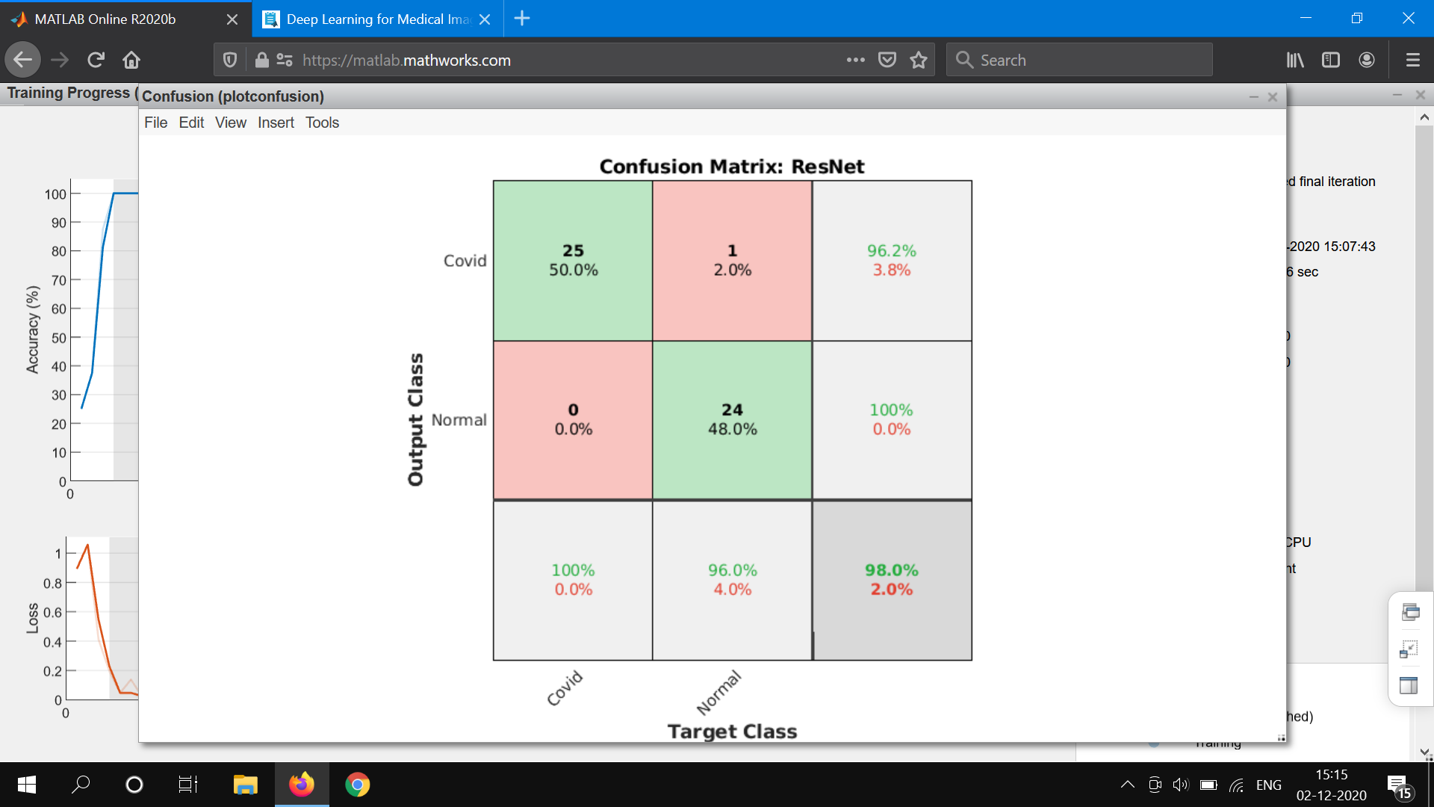

Slide 16
Resources
https://www.ncbi.nlm.nih.gov/pmc/articles/PMC7476608/
https://link.springer.com/article/

